Slide 1
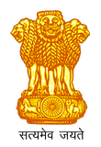
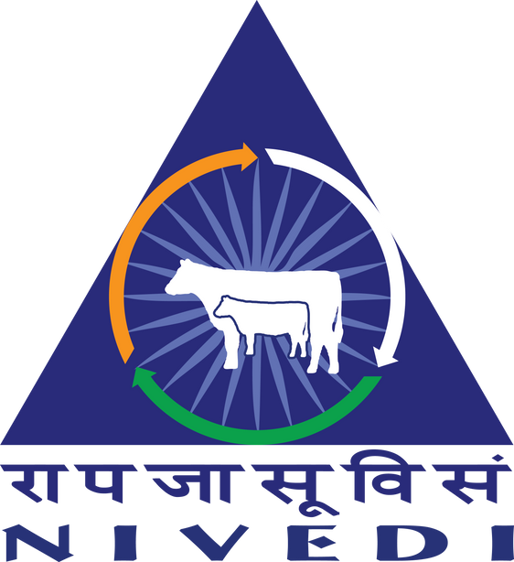
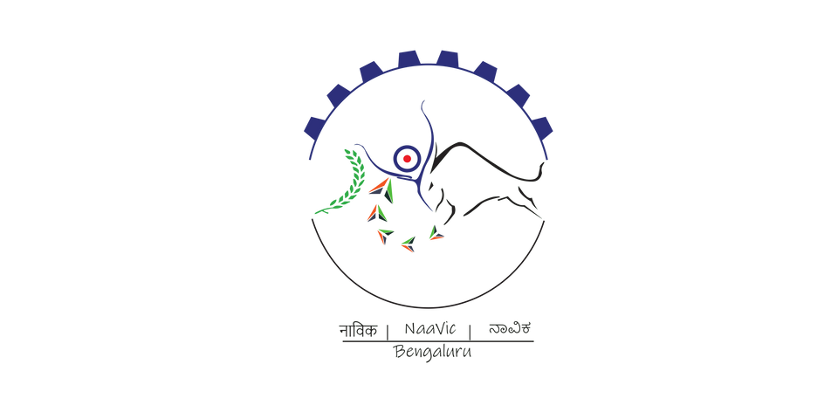

IDEATHON 2024
3d printer usage with fashion designing
REVOLUTIONIZE FASHION DESIGN WITH 3D PRINTING, SEAMLESSLY TRANSFORMING DIGITAL DESIGNS INTO TANGIBLE, AVANT-GARDE GARMENTS. ELEVATE CREATIVITY AND REDEFINE THE BOUNDARIES OF TRADITIONAL FASHION.
NaaViC- Agri- Business Incubation Centre, ICAR-NIVEDI,
Ramagondanahalli, Yelahanka-64

Slide 2
Introduction
Team Name: Printed Threads Innovation
Team Members: Shashank Katti
Name of the Institute: BMSIT
NaaViC- Agri- Business Incubation Centre, ICAR-NIVEDI,
Ramagondanahalli, Yelahanka-64

Slide 3
Problem
I assist fashion designers using 3D printers by streamlining the process of translating digital designs into physical prototypes. My capabilities include generating intricate 3D models, optimizing print settings for various materials, and providing real-time feedback to enhance the efficiency and precision of the fashion design prototyping workflow.
NaaViC- Agri- Business Incubation Centre, ICAR-NIVEDI,
Ramagondanahalli, Yelahanka-64

Slide 4
SOLUTION
PROPOSED SOLUTION:
INTEGRATING 3D PRINTING TECHNOLOGY INTO FASHION DESIGNING REVOLUTIONIZES THE INDUSTRY BY ENABLING CUSTOMIZED, SUSTAINABLE, AND ON-DEMAND PRODUCTION. UTILIZING ADVANCED 3D PRINTING TECHNIQUES ALLOWS DESIGNERS TO CREATE INTRICATE AND PERSONALIZED GARMENTS WITH UNPRECEDENTED PRECISION AND SPEED.
INNOVATIVE ASPECTS:
CUSTOMIZATION: 3D PRINTING EMPOWERS DESIGNERS TO TAILOR GARMENTS TO INDIVIDUAL PREFERENCES AND BODY SHAPES, FOSTERING A NEW ERA OF PERSONALIZED FASHION.
SUSTAINABLE PRODUCTION: BY MINIMIZING MATERIAL WASTE AND OFFERING ECO-FRIENDLY MATERIALS, 3D PRINTING CONTRIBUTES TO SUSTAINABLE FASHION PRACTICES, ALIGNING WITH THE GROWING DEMAND FOR ENVIRONMENTALLY CONSCIOUS DESIGN.
RAPID PROTOTYPING: DESIGNERS CAN ITERATE QUICKLY AND EFFICIENTLY, REDUCING THE TIME FROM CONCEPT TO MARKET, THUS ACCELERATING THE PACE OF FASHION INNOVATION.
COMPLEX GEOMETRIES: 3D PRINTING ENABLES THE PRODUCTION OF INTRICATE AND GEOMETRICALLY COMPLEX DESIGNS THAT WOULD BE CHALLENGING OR IMPOSSIBLE WITH TRADITIONAL MANUFACTURING METHODS.
ON-DEMAND MANUFACTURING: THE TECHNOLOGY FACILITATES ON-DEMAND PRODUCTION, REDUCING EXCESS INVENTORY AND MINIMIZING THE ENVIRONMENTAL IMPACT ASSOCIATED WITH MASS PRODUCTION.
NaaViC- Agri- Business Incubation Centre, ICAR-NIVEDI,
Ramagondanahalli, Yelahanka-64

Slide 5
UNIQUE SELLING PROPOSITION (USP)
Our 3D printing solution for fashion design stands out through its unparalleled precision, speed, and versatility. With cutting-edge technology, we offer a seamless integration of intricate design details and superior material options. Our user-friendly interface empowers fashion designers to bring their visions to life effortlessly, setting us apart from competitors. Elevate your creativity with our innovative 3D printing solution, where precision meets passion.
NaaViC- Agri- Business Incubation Centre, ICAR-NIVEDI,
Ramagondanahalli, Yelahanka-64

Slide 6
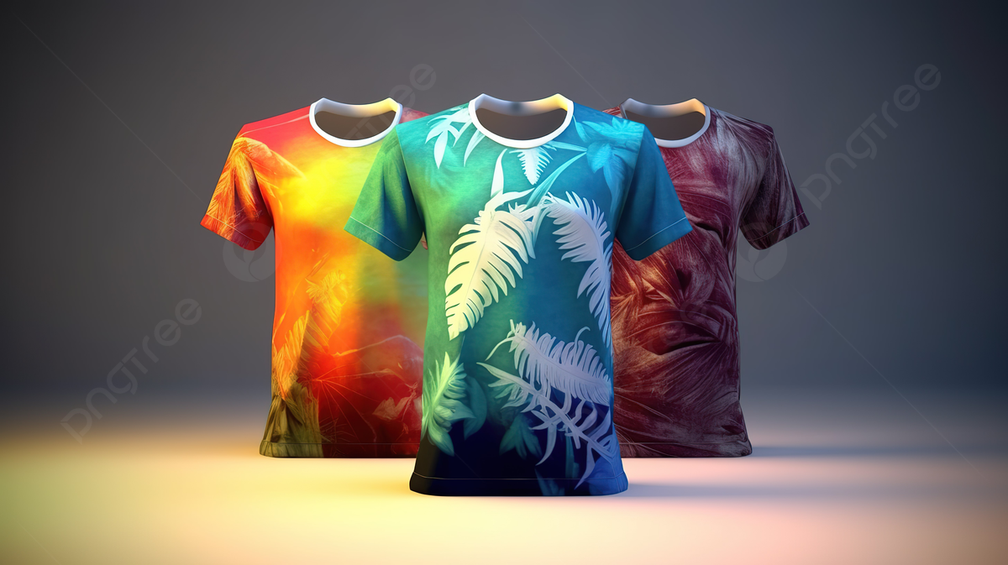

Slide 7
Investment
Sl. No. | Particulars | Amount
1 | Research and Development (R&D) | 10000
2 | Technology and Equipment | 3D PRINTER
3 | Production/ Manufacturing | Fashion Design
Any other cost component can be added
NaaViC- Agri- Business Incubation Centre, ICAR-NIVEDI,
Ramagondanahalli, Yelahanka-64

Slide 8
CONCLUSION
IN CONCLUSION, THE INTEGRATION OF 3D PRINTING TECHNOLOGY IN FASHION DESIGN MARKS A TRANSFORMATIVE LEAP, OFFERING DESIGNERS UNPRECEDENTED CREATIVE FREEDOM AND PRECISION. THE ABILITY TO FABRICATE INTRICATE, CUSTOMIZABLE DESIGNS EFFICIENTLY NOT ONLY ACCELERATES THE PRODUCTION PROCESS BUT ALSO FOSTERS INNOVATION AND SUSTAINABILITY IN THE FASHION INDUSTRY. AS 3D PRINTING CONTINUES TO EVOLVE, ITS SEAMLESS INTEGRATION WITH TRADITIONAL DESIGN METHODS HOLDS THE PROMISE OF REDEFINING THE FUTURE OF FASHION, PUSHING BOUNDARIES, AND SHAPING A MORE SUSTAINABLE AND PERSONALIZED APPROACH TO GARMENT PRODUCTION.
NaaViC- Agri- Business Incubation Centre, ICAR-NIVEDI,
Ramagondanahalli, Yelahanka-64

